Slide 1


Key Trends in U.S. Energy
33rd Annual Conference of The American Association of Blacks in Energy
Rob Schwiers
Chevron Corporate Strategic Planning
May 20, 2010
© 2010 Chevron Corporation
Notes:
1

Slide 2
Key Messages
Global energy demand poised to increase driven by economic development and income expansion in emerging economies
All sources of energy required to meet future energy demand
The global oil industry will be challenged to offset decline and meet projected rates of demand growth
Changes in policy are dampening future prospects for U.S. oil demand
Oil will remain predominant fuel used in transportation despite penetration of alternative vehicles and renewable liquid fuels
Growth in the power generation and industrial sectors underpin future growth in U.S. natural gas demand
The discovery and development of North America’s vast unconventional gas resources have enhanced energy security

Slide 3
Global Energy Demand Poised to Grow
Global Energy Demand 2010 – 2030
Million Barrels of Oil Equivalent Per Day
51% increase
2030
15% increase
Renewables
2030
Nuclear
2010
2010
Coal
Gas
Liquids
OECD
Non-OECD
Source: DOE EIA International Energy Outlook, updated May 2009

Slide 4
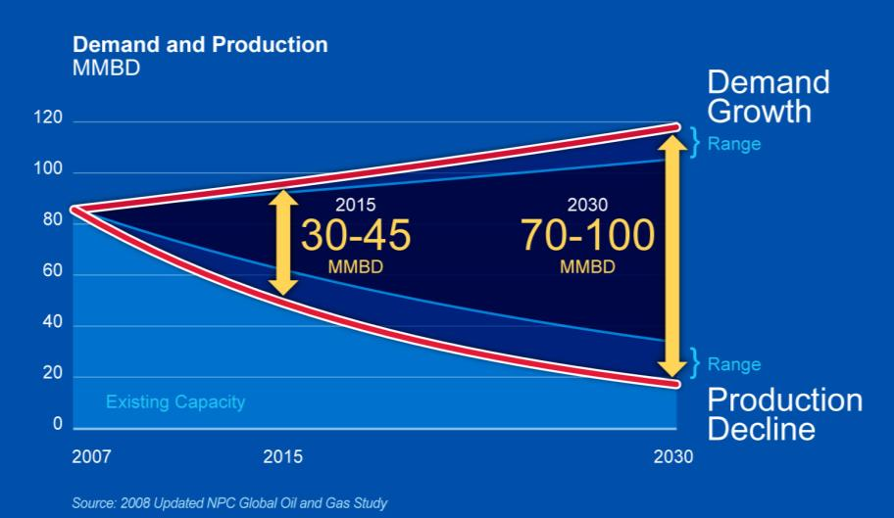
Long-Term Global Oil Supply Challenge
© 2010 Chevron Corporation
4
Notes:
4

Slide 5
All Sources of Energy Will be Required to Meet Projected Growth in U.S. Energy Demand
Highest Growth Expected from Renewable & Other Energy
…but Fossil Fuels Remain Dominant
% Change in U.S. Energy Demand 2007-2030
% of U.S. Energy Consumption
10%
8%
22%
23%
37%
2007
2030
Hydrocarbons Remain Critical in the Energy Mix
Oil/ Liquids
Natural Gas
Coal
Nuclear
Other & Renewables
Source: EIA Annual Energy Outlook 2010

Slide 6
Policy Environment Drives a Significant Shift in Future U.S. Oil Consumption
% of U.S. Oil Demand
Other
2007 FCST
Industry
5.5 MMBD
2010 FCST
Transport.
Source: EIA Annual Energy Outlook 2010 & Chevron Analysis

Slide 7

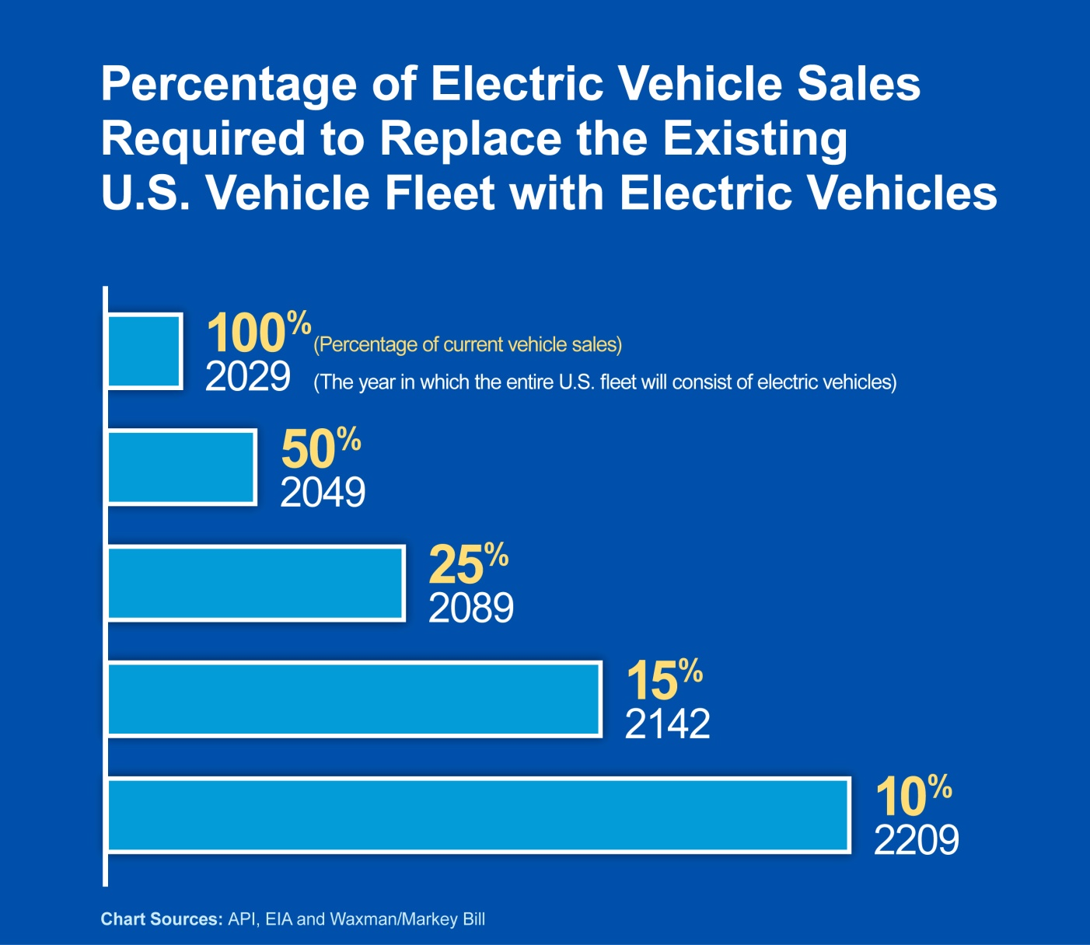
Recognizing Substitution toward Alternative Fuels in Transportation will Take Time. . .
© 2010 Chevron Corporation
7
Notes:
7

Slide 8
Biofuels Share of the Liquids Pool Increases, but Falls Short of Mandated Levels
2022 Mandate
Other Biofuels
Other Ethanol
Imports
Corn Ethanol
Source: EIA Annual Energy Outlook 2010 & Chevron Analysis

Slide 9
Industrial and Power Generation Drive Growth in U.S. Natural Gas Demand
Power Generation Capacity additions 2008 to 2035
Other
Hydropower*
1 (0.4%)
Residential & Commercial
Nuclear
8 (3%)
Coal
31 (12%)
Other Renewables
92 (37%)
250
gigawatts
Industrial
Power Generation
Other
2 (1%)
Natural gas
116 (46%)
* Includes pumped storage
Source: EIA Annual Energy Outlook 2010 & Chevron Analysis

Slide 10
Unconventional Gas Drives Down U.S. Imports
Trillion Cubic Feet of Resource
– North America
Tight Gas
2007 Outlook
CBM
66% decrease in imports by 2030
Shale Gas
2010 Outlook
Recoverable Conventional Gas Resources
Unconventional Gas Resources In Place
Source: EIA, IEA & Chevron Analysis
Notes:
The ultimately recoverable resource base of conventional gas in North America is 68.8 trillion cubic metres (2,428.6 trillion cubic feet). Source: IEA World Energy Outlook 2009 – table 11.2, pg 395
However, there are vast resources of unconventional gas. Total resource-in-place of unconventional gas in North America is 233 trillion cubic metres (8,224.9 trillion cubic feet). Source: IEA World Energy Outlook 2009 – table 11.3, pg 397
Estimates suggest that unconventional gas resources have increased the size of the domestic recoverable resource base by a factor of at least 2x—recognizing there is still huge uncertainty over long-term potential. As a result, higher domestic production is projected to reduce the level of LNG imports required in the U.S. by 66% in 2030—having obvious consequences on global LNG markets.
The size of the global resource base in place is staggering. The key question is whether or not the U.S. success can be repeated in other basins (Europe and China)?
The answer to this question will have huge implications on global LNG markets and future conventional gas developments.
Geology, access to market, environmental concerns, and lack of clear development regimes outside the U.S. all point to huge uncertainties in the future of unconventional gas making it perhaps the biggest wildcard, except perhaps Iraq, impacting global energy markets.

Slide 11
Q
A
&
11
Notes:
11

